Slide 1
A New Boxscore
Team Nona
Nathaniel Brown & Sonia Xu

Slide 2
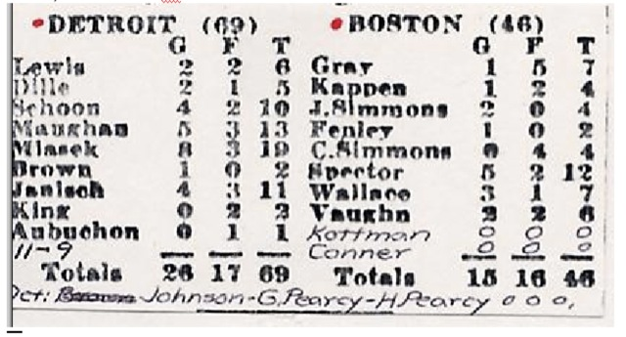
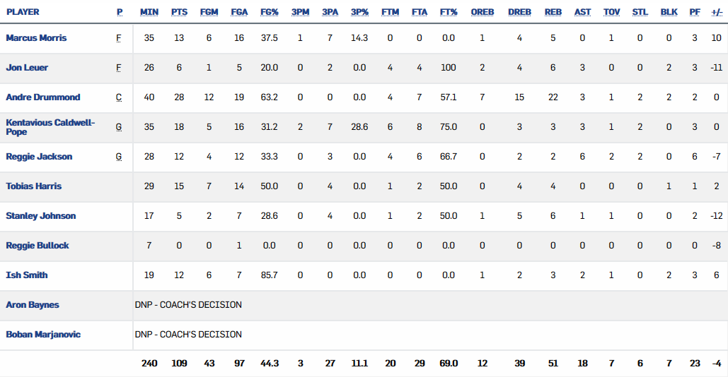
Through the years
Boston Celtics vs. Detroit Falcons, BAA, 1946
Boston Celtics vs. Detroit Pistons, NBA, 2017
2
2

Slide 3
Combining the Old & the New
Player Impact Estimate (PIE)
Single box-score statistic.
“In its simplest terms, PIE shows what % of game events did that player or team achieve.”
3
3

Slide 4
Title
Subtitle
Bullet
Bullet
Visualization
4
4

Slide 5
Title
Subtitle
Bullet
Bullet
Visualization
5
5

Slide 6
Title
Subtitle
Bullet
Bullet
Visualization
6
6

